Slide 1
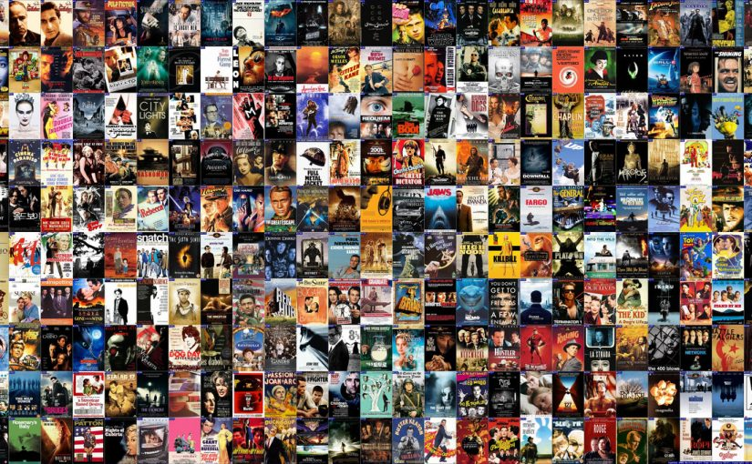
Movie Collector
Project 2 Application
Marcelino Esparza

Slide 2
Background condition
You love movies
There are many movies you already saw
There are a lot more you want to watch
How to keep track of them?
Sometimes a title is not enough to remember movie plot
How to easily check main movie detail, including trailer?
Answer: App
MovieCollector

Slide 3
What is:
MovieCollector
MovieCollector
is a web application that allows the movie fan to keep track of movies already seen, as well as the ones interested to see
In a very graphic and user-friendly fashion, user can browse list of movies. Hovering over a particular movie, user will know its duration, release year and imDb rating
In a single click, user can add a new movie to the data base
Application allows user to sort movies either by release year or by rate (by default movies are sorted by title)
Clicking a movie will provide additional movie detail, as well as:
Label the movie as “Watched”
Remove movie from the list
Watch movie trailer

Slide 4
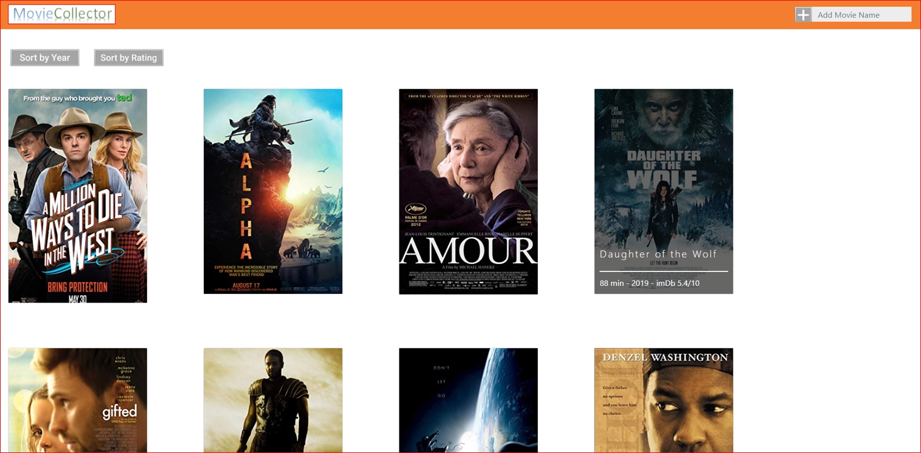
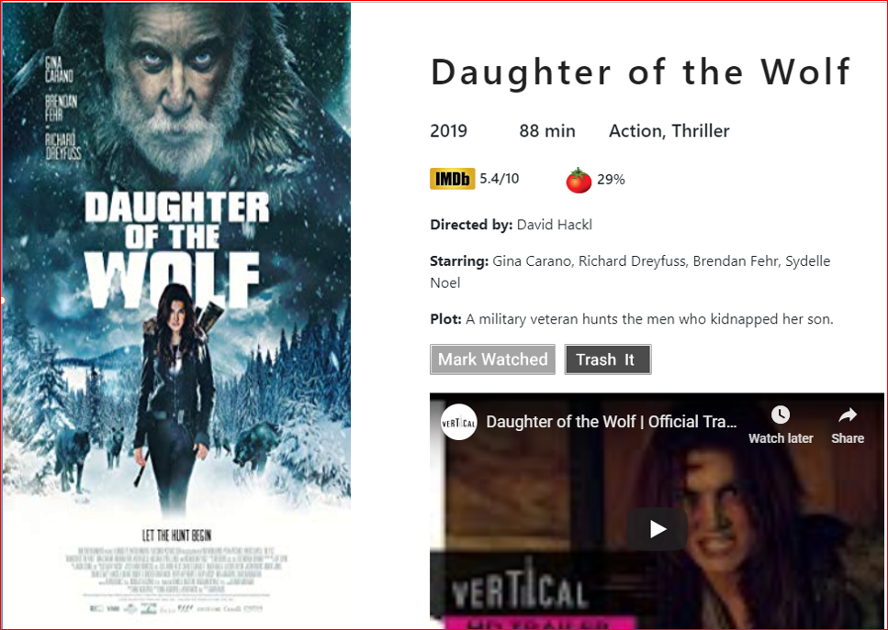
Graphic design

Slide 5
Technology applied
Main purpose of the project was to apply the CRUD actions of Sequelize to a MySQL data base under an MVC framework
Additionally this project incorporates Express.js as server framework, Handlebars as templating manager, Bootstrap for formatting and video streaming. JawsDB is also used as Heroku database add-on
Two movie API’s were called to get movie detail (omdbapi.com) and movie trailer (api.themoviedb.org)
Future features: Capability to upload from a file or reading directly from a storage device

Slide 6
Live Demo
MovieCollector

Slide 7

Questions ?

